Slide 1
Finance group
Tran Kim Ngan Nguyen
Hassan Absar

Slide 2
Data introduction
Time series: Bitcoin closing prices
Time: 01-11-2014 to 02-11-2024 (10 years)
Number of samples: 3655
Baseline models: Prophet, Chronos,

Slide 3
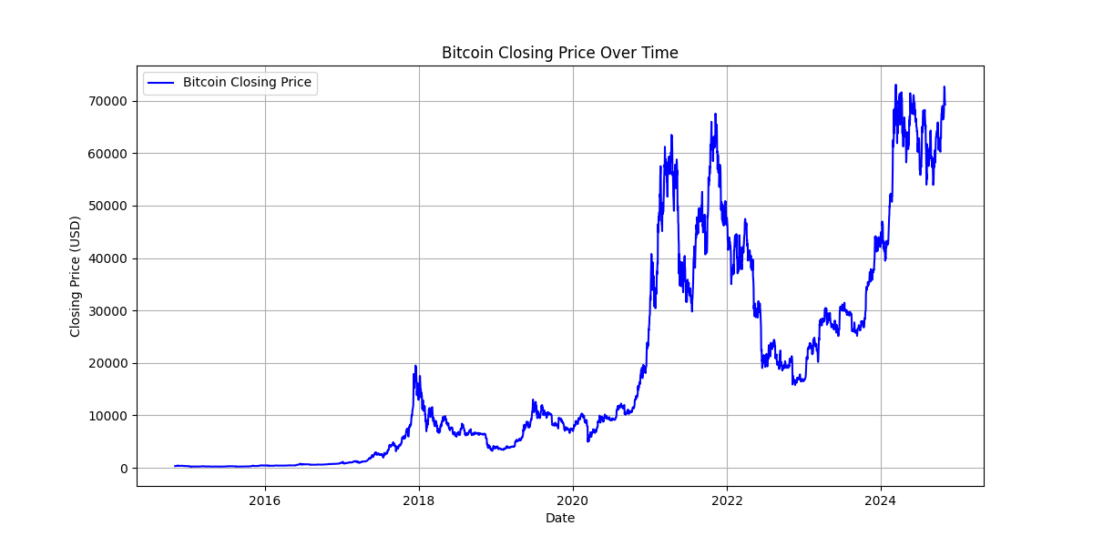
Bitcoin Price Data Plot

Slide 4
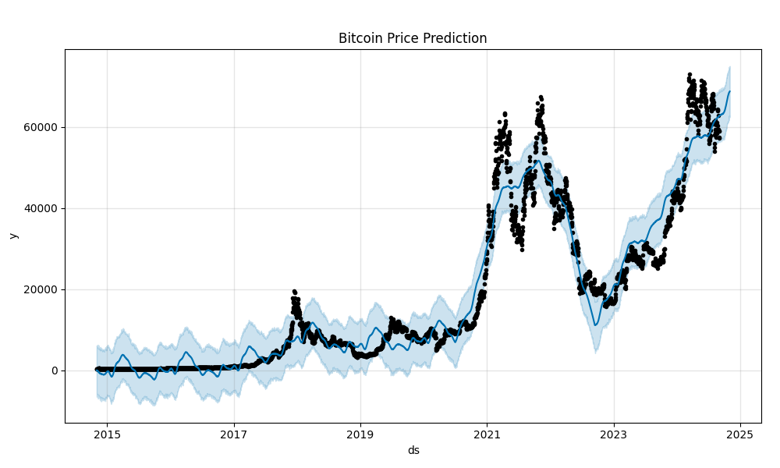
Prophet Model (prediction plot)

Slide 5
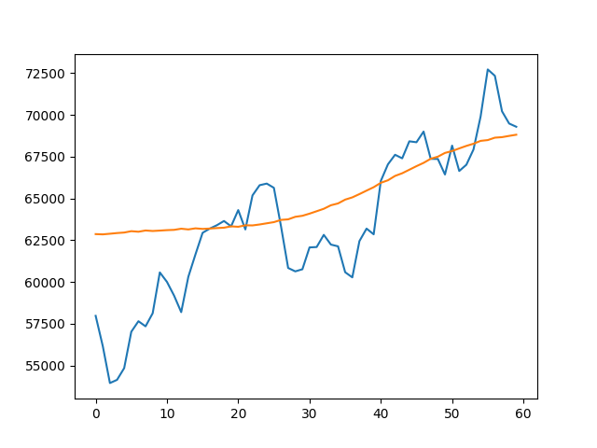
Prophet Model
Prediction length: 60 days
R-squared score: 0.43
Actual vs predicted plot

Slide 6
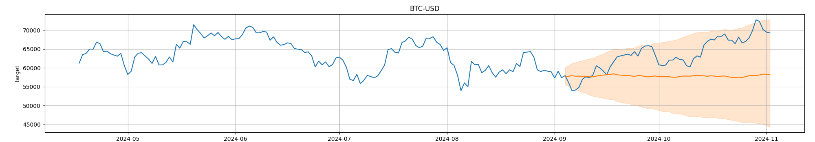
Chronos Model
Prediction length = 60
R-squared score: -1.59
Actual vs predicted plot

Slide 7
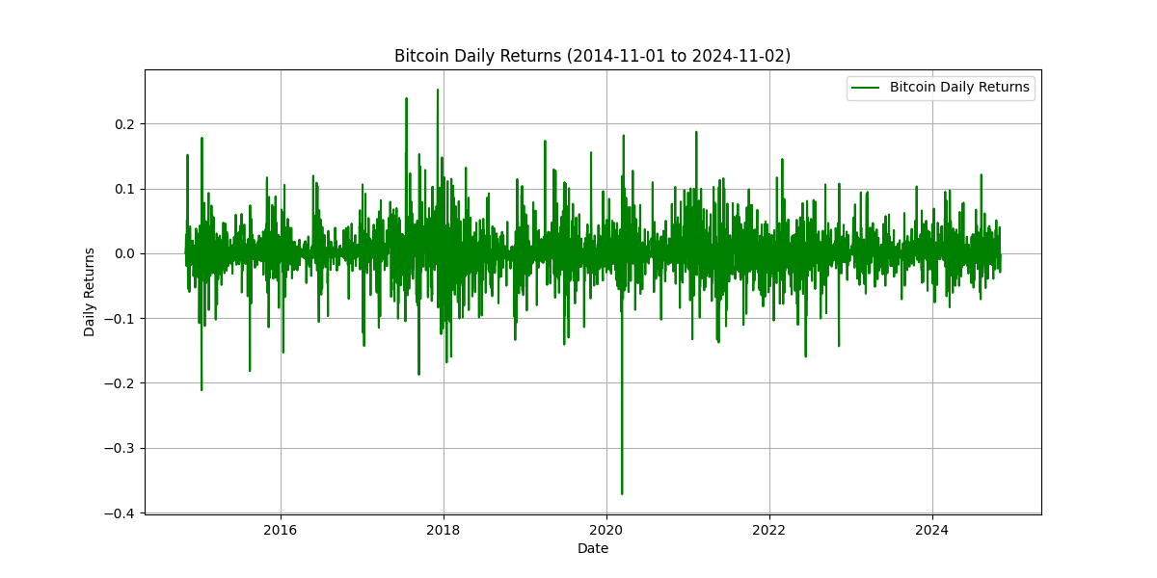
GARCH Model

Slide 8
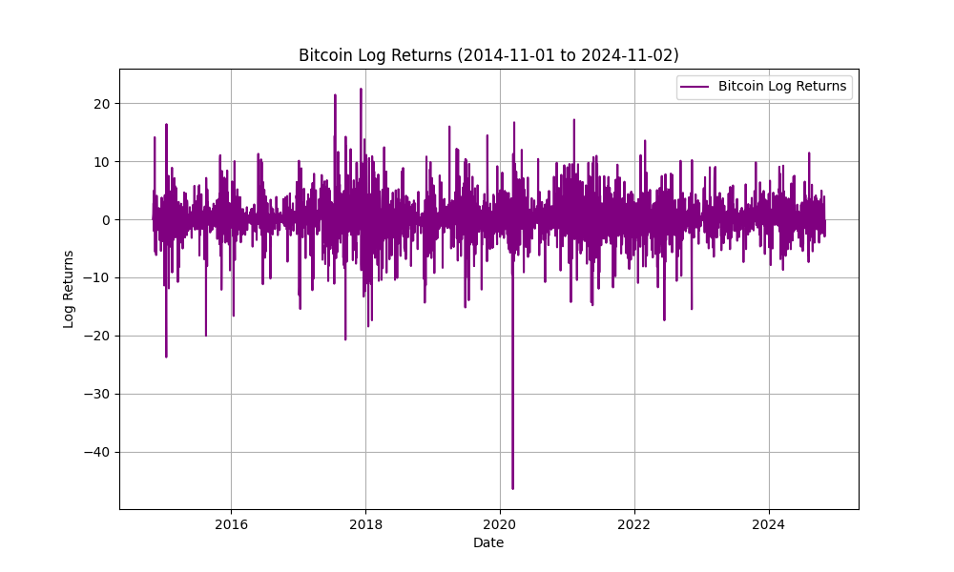
GARCH Model

Slide 9
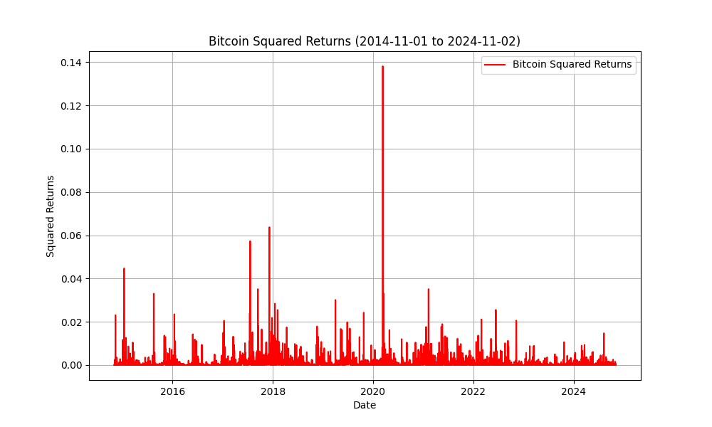
GARCH Model

Slide 10
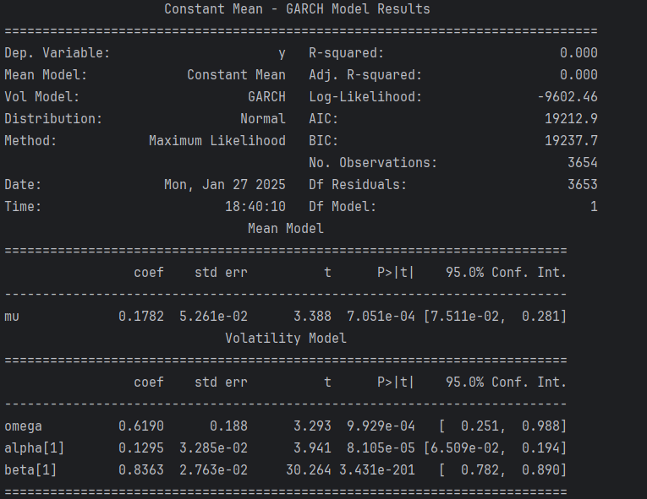
GARCH Model

Slide 11
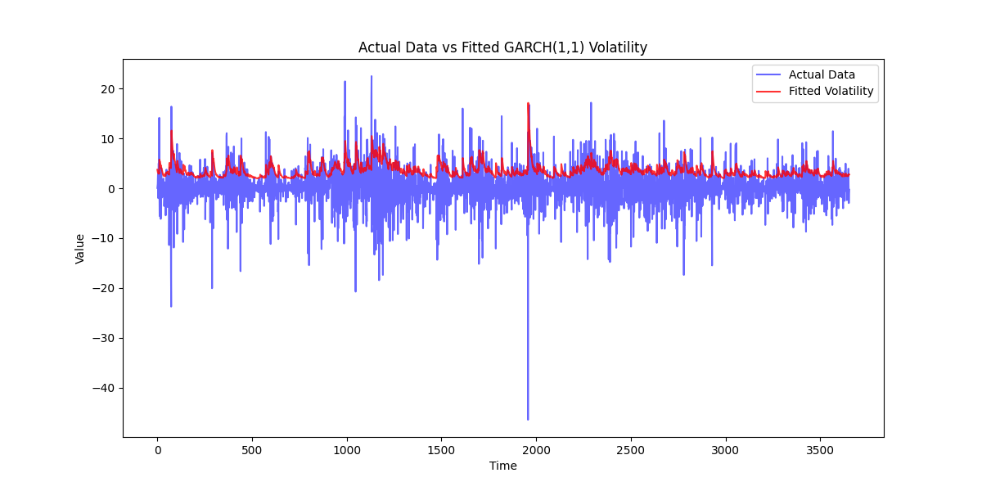
GARCH Model (fitting plot)

Slide 12
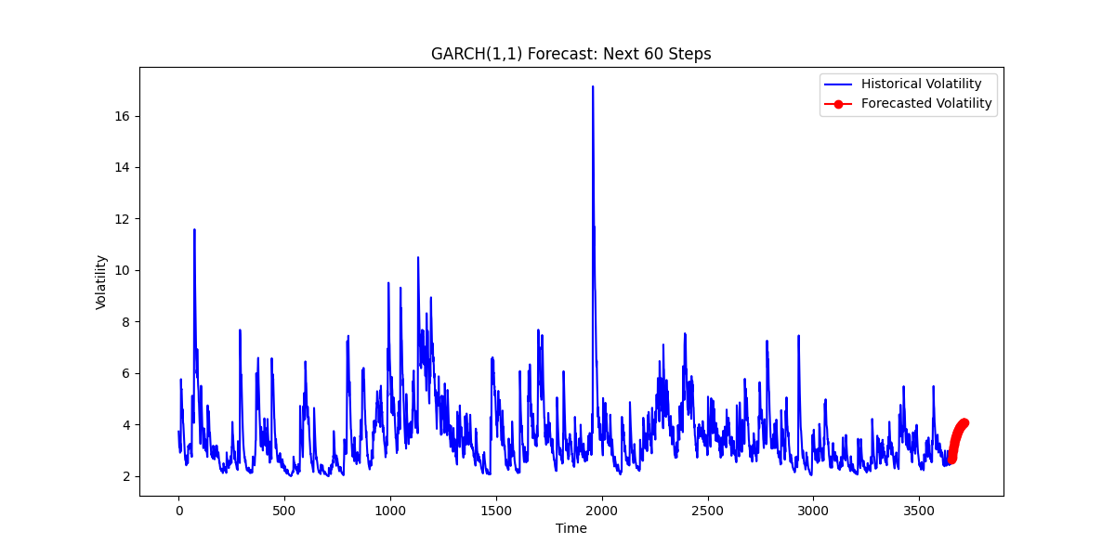
GARCH Model
Prediction length = 60
R-squared score: -0.98
MSE(Mean Squared Error): 26.53

Slide 13
Copula
List of 10 crypto currencies:
"BTC-USD“
"ETH-USD“
"BNB-USD“
"XMR-USD“
"USDT-USD“
"ADA-USD“
"XRP-USD“
"DOGE-USD“
"LTC-USD”
"XLM-USD“

Slide 14
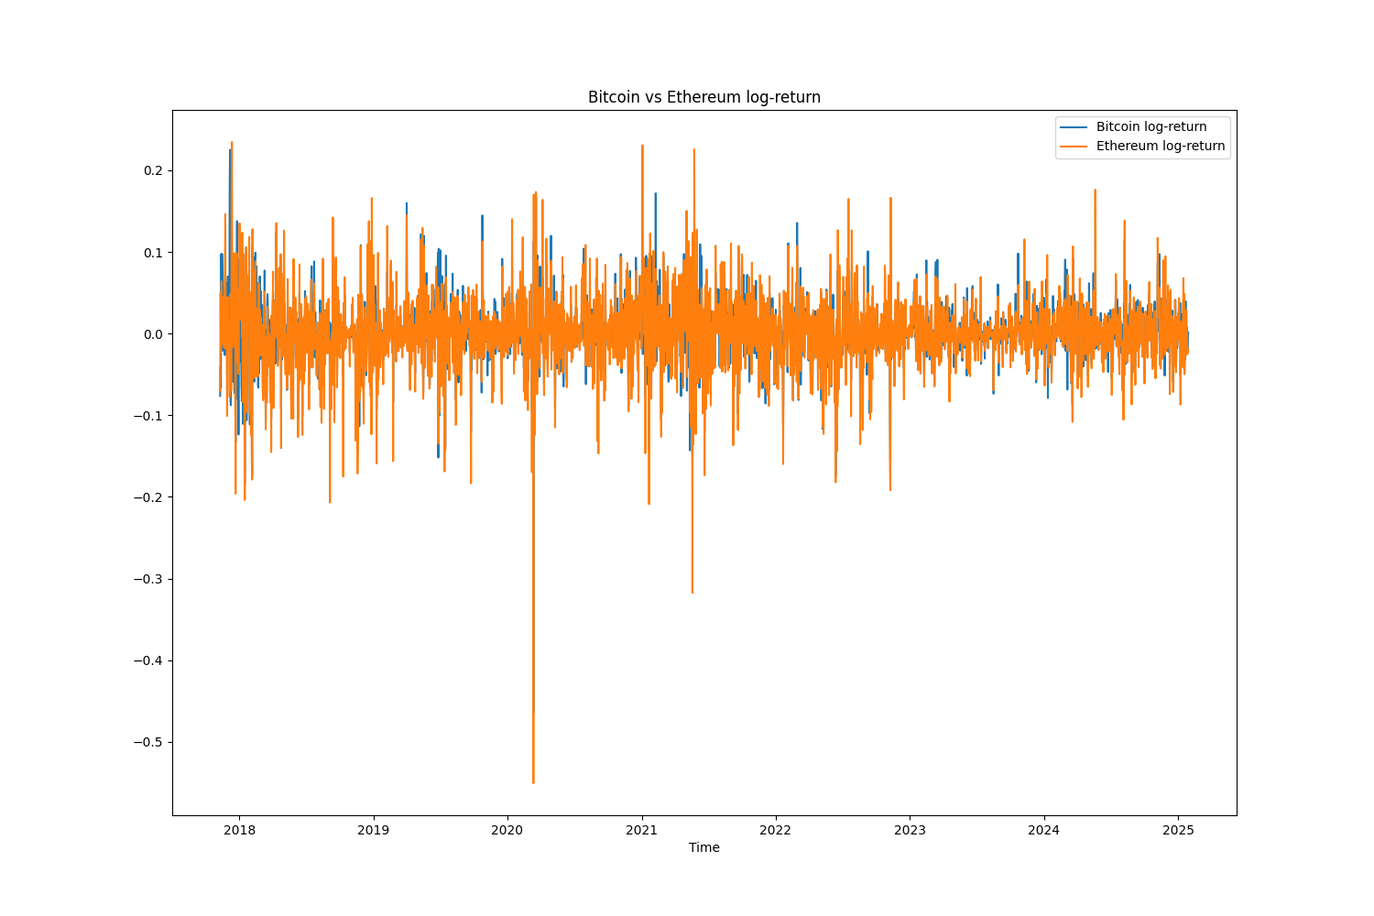
Copula

Slide 15
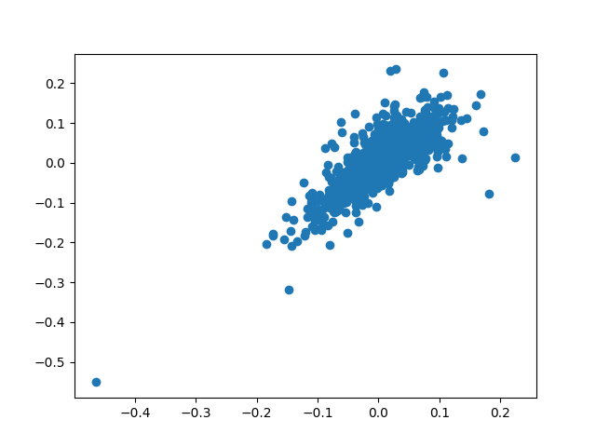
Copula
Scatter plot of BTC vs ETH

Slide 16
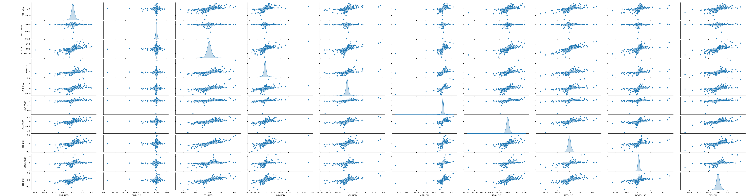
Copula
Pairwise Scatter Plots

Slide 17
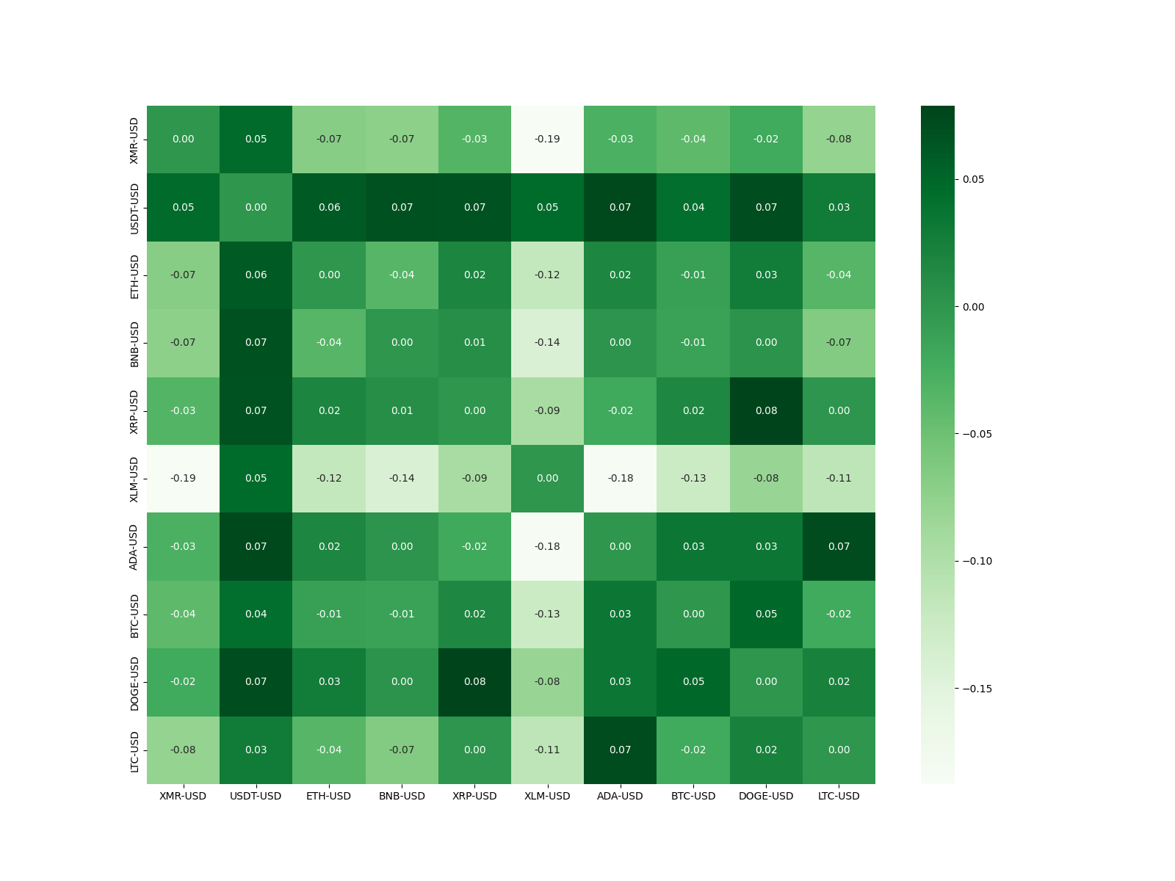
Copula
Correlation heatmap

Slide 18
Thank you for listening
Finance Group

